Slide 1

A Project Review on
POWER SYSTEM FAULT DIAGNOSIS USING MACHINE LEARNING
by
under the guidance of
Dr . S. Hemachandra M.Tech., Ph.D.
Professor
DEPARTMENT OF ELECTRICAL AND ELECTRONICS ENGINEERING
SREE VIDYANIKETHAN ENGINEERING COLLEGE
(AUTONOMOUS)
A.RANGAMPET, TIRUPATI – 517 102
(2018 –2019)
EDAGOTTI PAVANKUMAR | 16121A0253
AVILALA DEDEEPYA | 16121A0208
GAYAKAWADA CHANDRASEKHAR | 16121A0265
AVULA PRAVALIKA | 16121A0209

Slide 2
Contents :
Objective
Introduction
Literature Survey
Conclusion
References

Slide 3
Objective
Energy conversion of Thermoelectric modules and Special features when compared to other devices .
Applications of thermoelectric modules where it plays a vital role.

Slide 4
Introduction
Energy conversion is the major process , that is involved in our daily life.
We will convert one form of energy to another form for our flexibility.
We are getting electrical energy from many ways and we are converting this electrical energy into many forms for many purposes.
Thermal to electrical conversion have many ways and involves many stages.
One of the simplest way is by utilising the thermoelectric effect.
It involves only stage conversion.
Thermoelectric modules are working based on Thermoelectric effect.

Slide 5
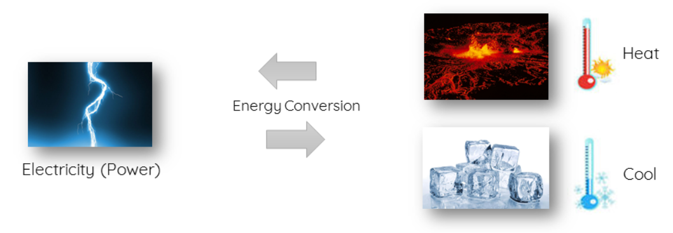
(Cont..)
Fig. 1 . Energy Conversion TEM
Thermoelectric modules are solid state devices which transform temperature difference directly into electricity and vice versa.

Slide 6
(Cont..)
Other names for Thermoelectric Modules are
Thermoelectric Cooler (TEC)
Thermoelectric Generator (TEG)
Peltier Cooler
Peltier Plates
Peltier modules etc.

Slide 7
Literature Survey
The discussion on thermoelectric effect start from 1822, Thomas Johann Seebeck has found a relation between temperature difference and the magnetic field. This is known as the Seebeck Effect.
Later in 1834, Peltier found that an electric current would produce heating or cooling at the junction of two dissimilar metals. This is known as the Peltier Effect.
In 1854, William Thomson (Lord Kelvin) described the interrelationship between Seebeck Effect and Peltier Effect through thermodynamics. This relation leads to predict the third thermoelectric effect. Now known as the Thomson Effect.

Slide 8
(Cont..)
In 1949 Abram Fedorovich Ioffe developed the modern theory of thermoelectricity using the concept of the 'figure of merit’ ZT, culminating in the classic texts on Semiconductor Thermoelements and Thermoelectric Cooling (1956). Ioffe also promoted the use of the semiconductors in thermoelectrics and semiconductor physics to analyze results and optimize performance.
In 1954, H. Julian Goldsmid used thermoelements based on Bi2Te3.
After 2000, there are so many improvements in the thermoelectric materials to improve ZT.

Slide 9
(Cont..)
In 2007, Simon Lineykin and Shumuel Ben Yaakov proposed a simulation model from the datasheet for thermoelectric modules for the softwares like PSPICE.
In 2013, Sri Harsha Choday proposed Thin-film Thermoelectric modules which can handle high heat flux and significant improvement in ZT , but this is not silicon compatible.
In 2014, Robert A.Porely proposed Powder based Thick film Thermoelectric devices. These devices have great potential for Energy Harvesting.
In 2017, Hugo Cesor Rocha and Protasio De Souza proposed a method for the calculation of parameters of Thermoelectric Modules using Harmen Method and found out the degradation of modules due to degradation of microstructures of TEG solder junctions.

Slide 10
Working Principle of Thermoelectric Modules
Thermoelectric Modules are working based on the thermoelectric effect
Thermoelectric effect is made up of three different effects
In the operation of Thermoelectric modules Seebeck Effect and Peltier Effect will play a major role and Thomson Effect is used for the direction of the heat flow only.
Seebeck Effect
Peltier Effect
Thomson Effect

Slide 11
(Cont..)
Thermoelectric Modules can be operated in two modes.
In Generator Mode Temperature difference will be converted into Direct Current (DC) and module is called as Thermoelectric Generator (TEG).
In Heater/Cooler mode electricity will be converted into heat energy.
One side will be heated up and another side will be cooled simultaneously.
Generator Mode
Heater/Cooler mode

Slide 12
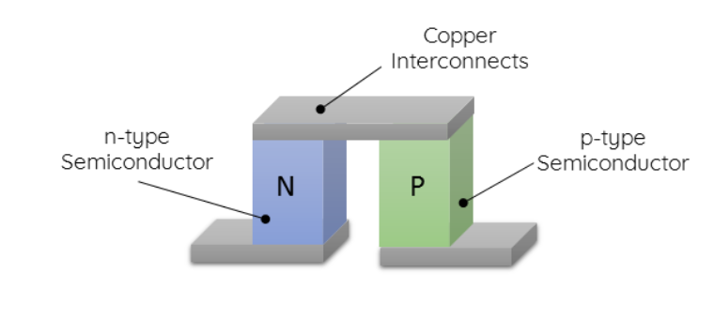
(Cont..)
Fig. 2. Basic Building Block Of TEM (Semiconductor Couple)

Slide 13
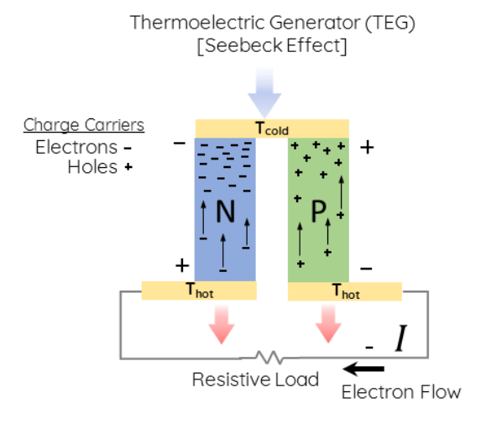
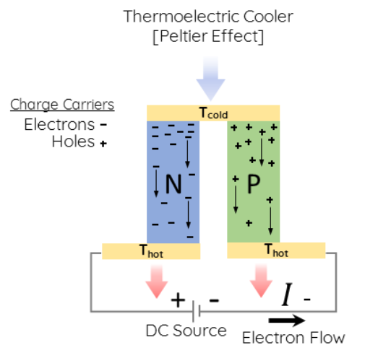

(Cont..)
Fig. 3. Generator Mode
Fig. 4.Cooler Mode

Slide 14
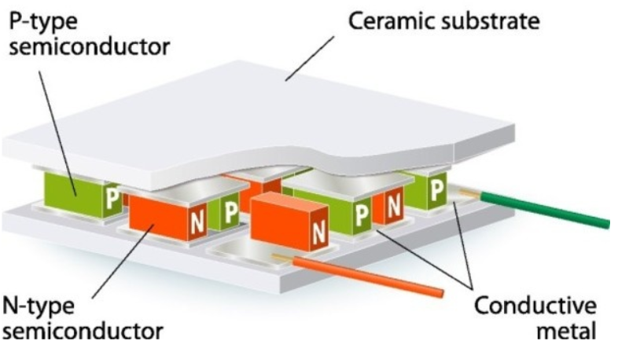
(Cont..)
Fig. 5. Thermoelectric Module
Thermoelectric Module is an integrated component of Semiconductor Couples that are connected electrically in Series and Thermally in Parallel.

Slide 15
Special Features of Thermoelectric Modules
No moving parts
Small size and Weight
Ability to Cool below Ambient temperature
Cooling and heating will be possible with only one device
Precise temperature control
High reliability

Slide 16
(Cont..)
Electrically quite operation
Operation in any orientation
Spot cooling
Environmental friendly
Fast response time
Its main drawbacks are low power efficient, it can handle only a certain amount of heat flux.
Even though these devices are having drawbacks , due its special features these devices had been using in many fields.

Slide 17
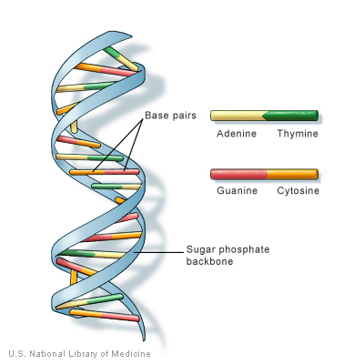
DNA Amplification using TEM
Deoxyribonucleic acid ( DNA ) is molecule composed of two chains that coiled around each other to form a double helix carrying structure.
DNA is carrying our genetic instructions like growth , development , functioning and reproduction etc.
DNA amplification is an essential tool for biologists, DNA forensic labs, and many other research labs for the study of genetic material.
Fig.6. Structure of DNA

Slide 18
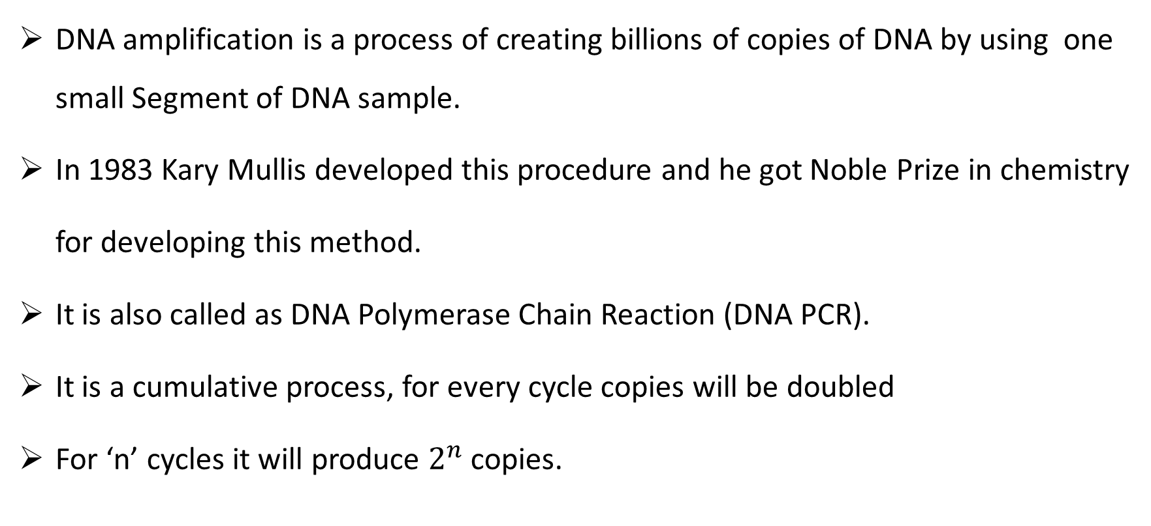
DNA amplification is a process of creating billions of copies of DNA by using one small Segment of DNA sample.
In 1983 Kary Mullis developed this procedure and he got Noble Prize in chemistry
for developing this method.
It is also called as DNA Polymerase Chain Reaction (DNA PCR).
It is a cumulative process, for every cycle copies will be doubled
For ‘n’ cycles it will produce $2^{n}$ copies.

Slide 19
(Cont..)
It consists of three stages
Denaturation
Annealing
Extension/Elongation
Applications of DNA PCR :
Gene cloning and Manipulation
Functional analysis of genes
Diagnosis and monitoring hereditary diseases
Amplification of ancient DNA
Analysis genetic fingerprints for DNA profiling etc.

Slide 20
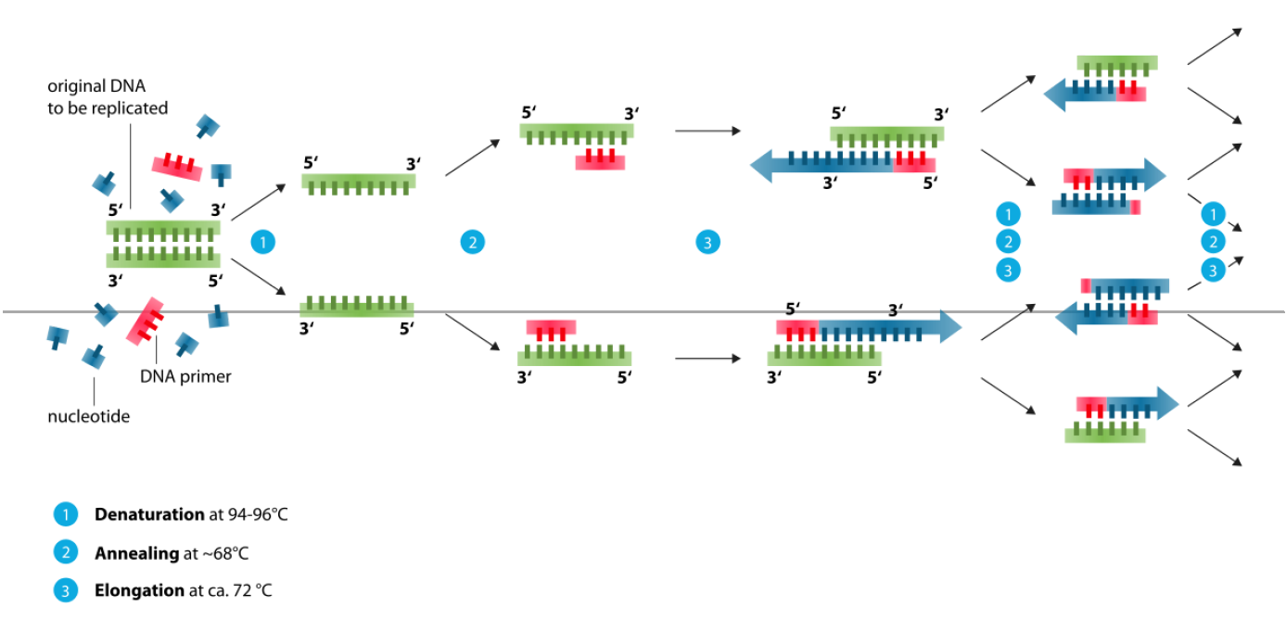
(Cont..)
Fig. 7. DNA Polymerase Chain Reaction

Slide 21
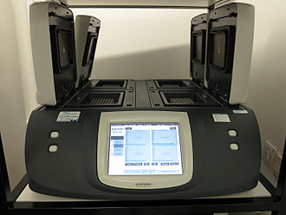
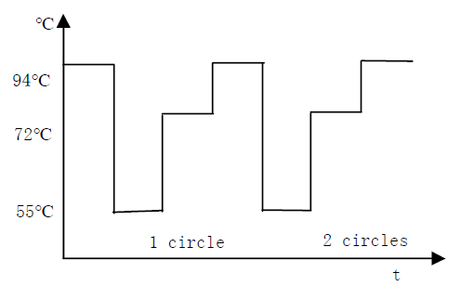
(Cont..)
Thermal Cycler is the device used in Polymerase chain reaction , it will produce the cycles of heat that is required for PCR.
Fig. 8. Thermal Cycler
Fig. 9. Two cycles for PCR

Slide 22
Other Applications of Thermoelectric Modules
Power Generation Applications
Radio isotope Power Generation in Spacecrafts
Waste heat recovery form the Industries
Wearable devices
Implantable devices etc
Cooling and Heating Applications
Small refrigerators
Electronics and CPU cooling
Battery Thermal Management
Zonal climate control
Beverages Heating and Cooling
Laser cooling etc

Slide 23
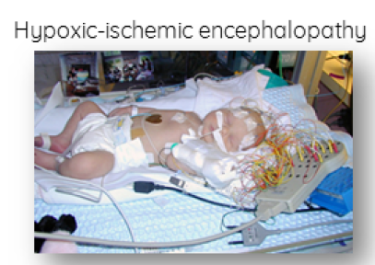
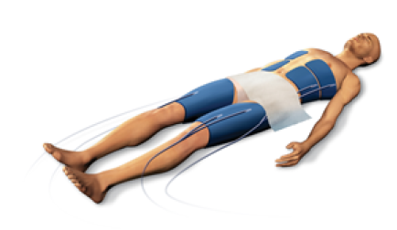
(Cont..)
Therapeutic Applications
Hypoxic – ischemic encephalopathy
Therapeutic Hypothermia
Low grade tissue injuries
Fig. 10.Hypoxic-ischemic encephalopathy
Fig. 11.Therapetic Hypothermia

Slide 24
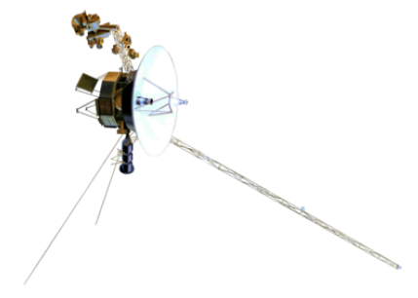
Case Study
Voyager 1 and Voyager 2 are the two NASA spacecrafts that are launched 1977. These spacecrafts are still communicating with base stations.
These mission of these spacecrafts are exploration of Interstellar space and outer planetary heliosphere.
These are equipped with Radio Isotope Thermoelectric Generators to produce electrical energy.
Fig.12.Model of Voyager Spacecraft design

Slide 25
Conclusion
Thermoelectric Devices are the most valuable devices. Even though these devices having some drawbacks, due to their special features like small size, less weight, precise temperature control and reliability these devices have been using in many fields such as medical, space research etc. The global market for these devices is increasing day by day due to technological improvements.

Slide 26
REFERENCES
[1] | Y. Wang, M. Liu and Z. Bao, "Deep learning neural network for power system fault diagnosis," 2016 35th Chinese Control Conference (CCC), Chengdu, 2016, pp. 6678-6683.
[2] | Michau, Gabriel & Palmé, Thomas & Fink, Olga. (2017). Deep Feature Learning Network for Fault Detection and Isolation.
[3] | Florian Rudin, Guo-Jie Li and Keyou Wang, “An Algorithm for Power System Fault Analysis based on Convolutional Deep Learning Neural Networks”, International Journal of All Research Education and Scientific Methods (IJARESM), Volume 5, Issue 9, September- 2017.
[4] | B. Bhattacharya and A. Sinha, "Intelligent Fault Analysis in Electrical Power Grids," 2017 IEEE 29th International Conference on Tools with Artificial Intelligence (ICTAI), Boston, MA, 2017, pp. 985-990.
[5] | H. A. Tokel, R. A. Halaseh, G. Alirezaei and R. Mathar, "A new approach for machine learning-based fault detection and classification in power systems," 2018 IEEE Power & Energy Society Innovative Smart Grid Technologies Conference (ISGT), Washington, DC, 2018, pp. 1-5.
[6]
[7]
[8]

Slide 27
[5] Xiaobo Qiu, Jinggi Yuan, “Temperature Control for PCR Thermocyclers Based on Peltier - Effect Thermoelectric”, 2005 IEEE Engineering in Medicine and Biology 27th Annual Conf., pp. 7509 -7512, Jan. 2006. [6] Introduction to Thermoelectrics and Medical Applications, Retrieved from https://thermoelectricsolutions.com [7] Polymerase Chain Reaction, Retrieved from https://en.wikipedia.org/wiki/Polymerase_chain_reaction [8] History of Thermoelectric Effects, Retrieved from http://www.thermoelectrics.Caltech.edu/thermoelectrics/history.html

Slide 28


Slide 29


